Slide 1









FINANCIAL ANALYSIS
Created by Jatin Limaye

Slide 2
INTRODUCTION
In today’s dynamic financial landscape, banks and financial institutions are increasingly relying on data-driven insights to enhance their strategies and operations. As a Financial Data Analyst, my objective is to leverage credit card usage data and financial metrics to drive actionable insights through advanced analytics. Utilizing Power BI and DAX (Data Analysis Expressions), I will perform a comprehensive analysis to assess key performance indicators (KPIs) that reflect customer behavior, credit utilization, and delinquency risks

Slide 3

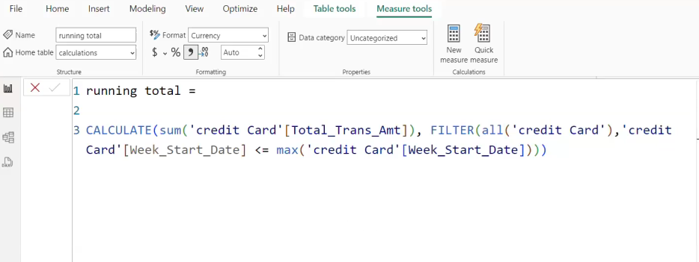

Q1. Running Total of Credit Card Transactions.

Slide 4
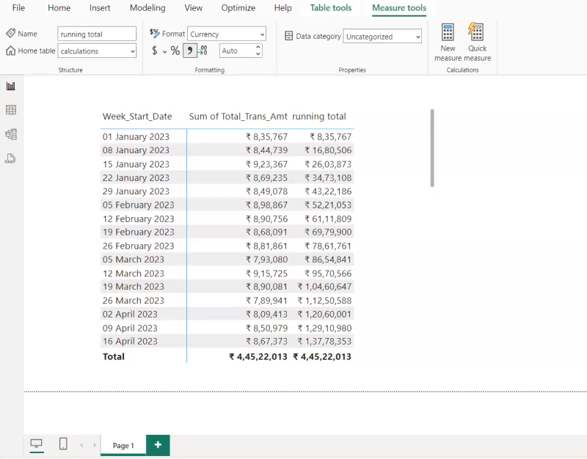

Slide 5
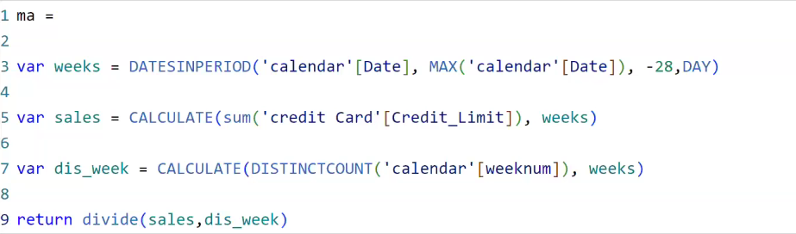
Q2.Calculate the 4-week moving average of the creditLimit for each client.

Slide 6
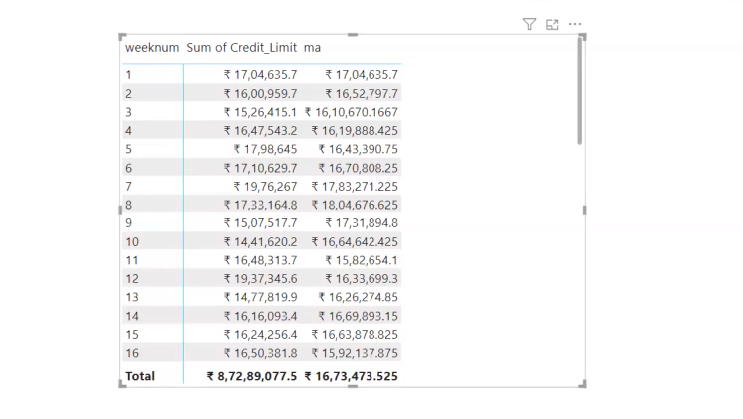

Slide 7
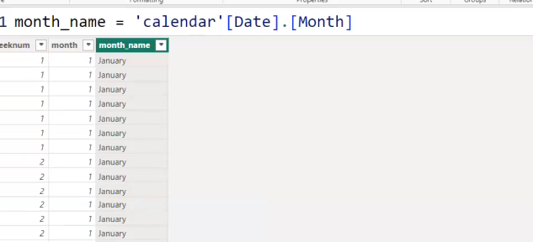
Q3.Calculate the mom% growth and wow% groth on transaction amount.

Slide 8
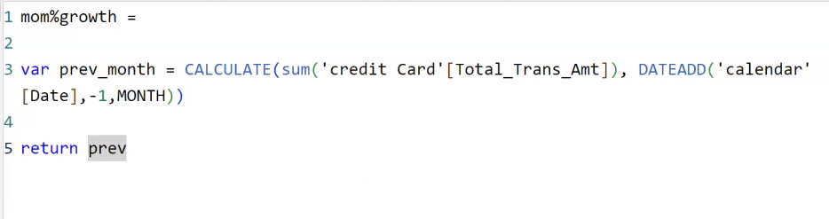
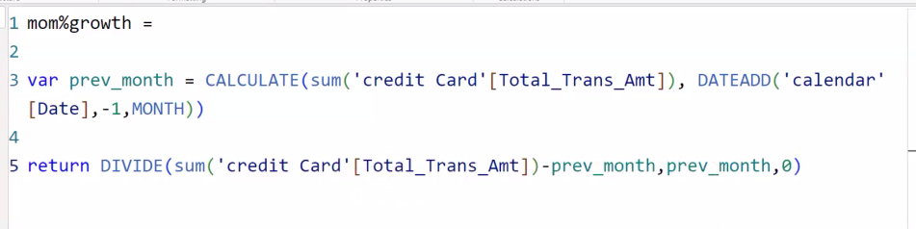

Slide 9
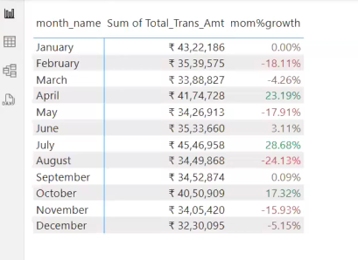
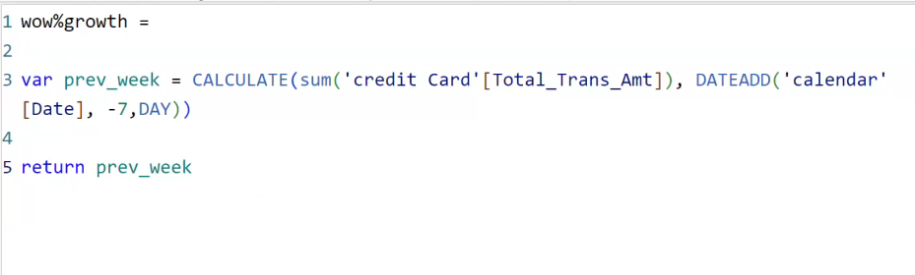

Slide 10
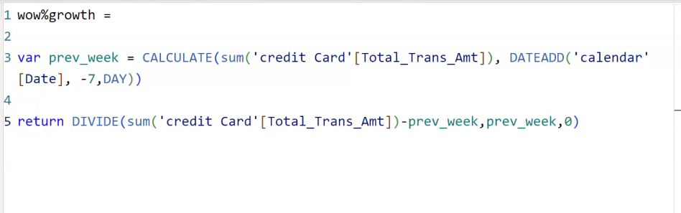
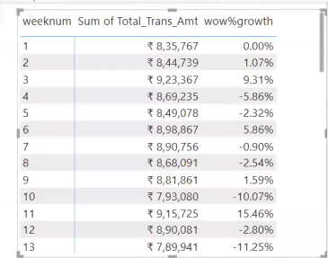

Slide 11
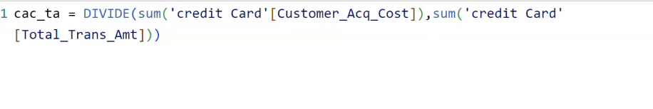
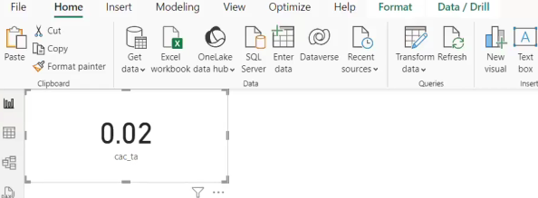
Q4.Calculate Customer Acquisition Cost (CAC) as a Ratio of Transaction Amount.

Slide 12
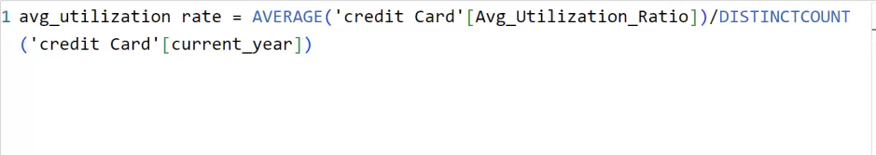
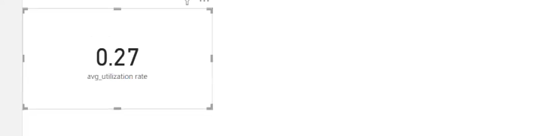
Q5.Calculate the yearly average of avg_utilization_ratio for all clients.

Slide 13
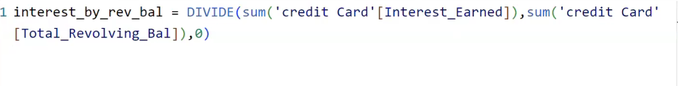
Q6.Calculate the percentage of Interest_Earned compared to Total_Revolving_Bal for each client.

Slide 14
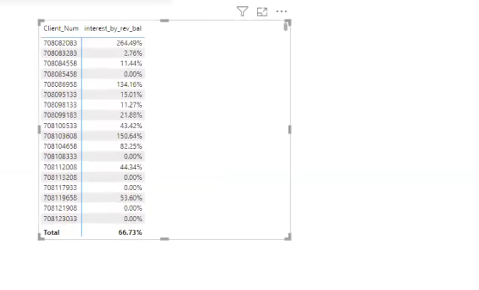

Slide 15
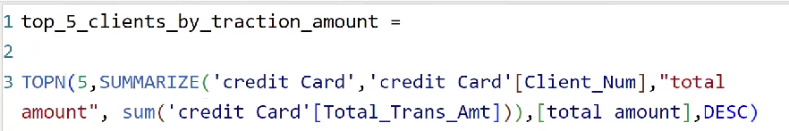
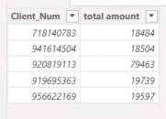
Q7.Calculate Top 5 Clients by Total Transaction Amount.

Slide 16
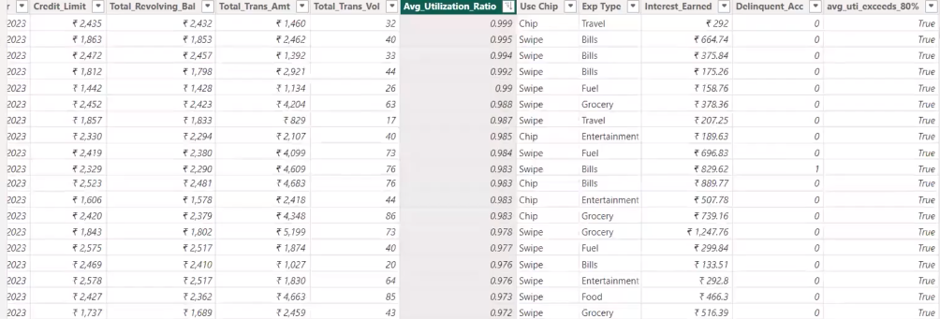
Q8.Identify clients whose Avg_Utilization_Ratio exceeds 80%.

Slide 17
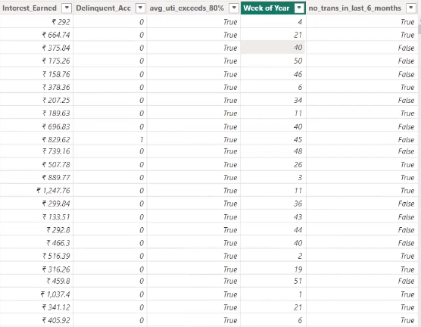
Q9.Customer Churn Indicator: Create a KPI that flags clients who have not made any transactions (Total_Trans_Amt = 0) in the last 6 months.

Slide 18
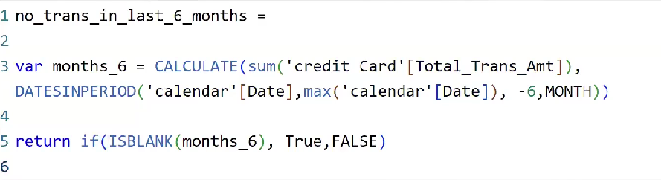

Slide 19
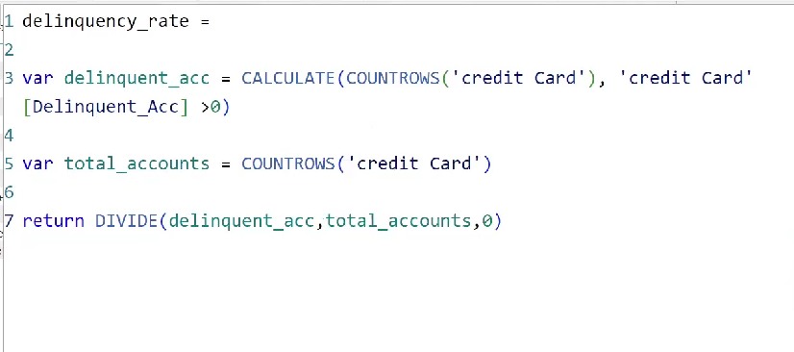
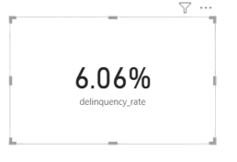
Q10.Delinquency Rate: Calculate the percentage of clients with Delinquent_Acc > 0.

Slide 20
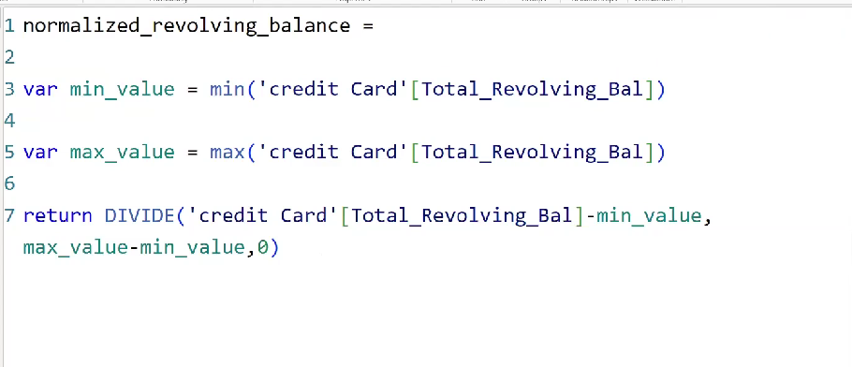
Q11.Credit Risk Score: Create a score for each client based on their Avg_Utilization_Ratio, Delinquent_Acc, and Total_Revolving_Bal.

Slide 21
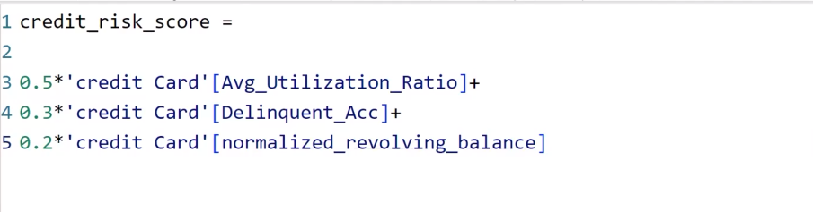
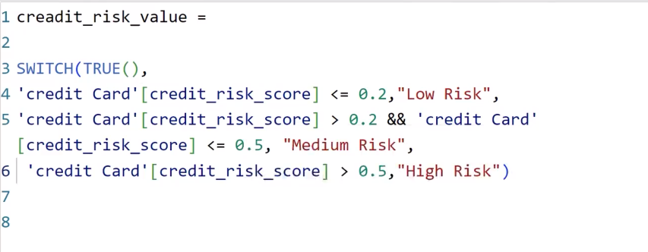

Slide 22
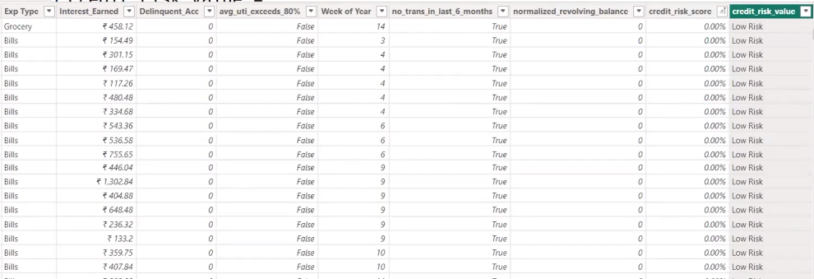

Slide 23
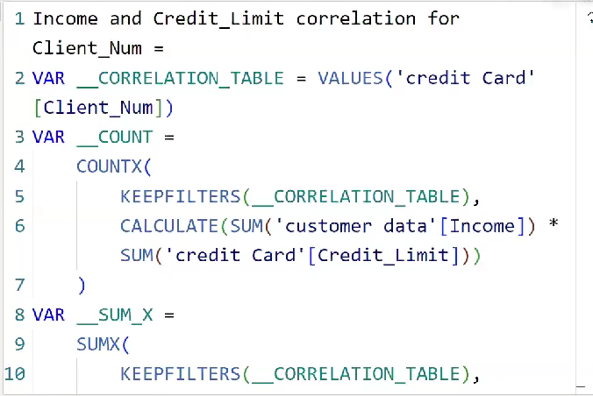
Q12.Income vs Credit Limit Correlation: Show the correlation between Income and Credit_Limit for all clients.

Slide 24



Slide 25
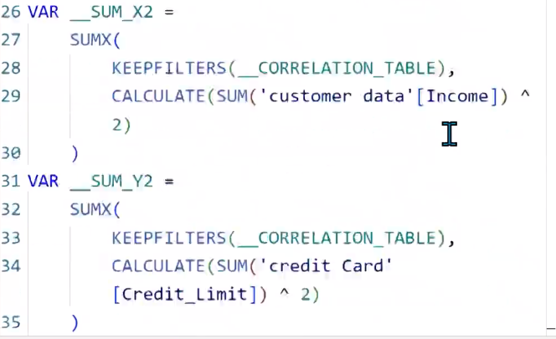

Slide 26
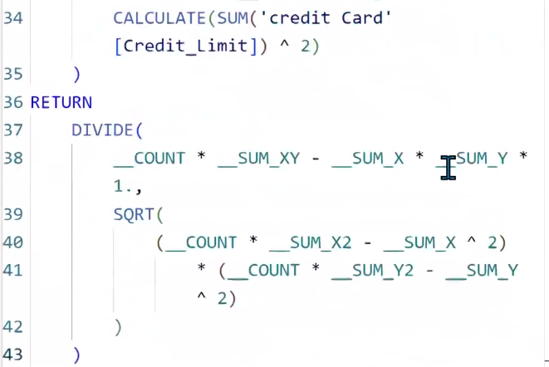

Slide 27
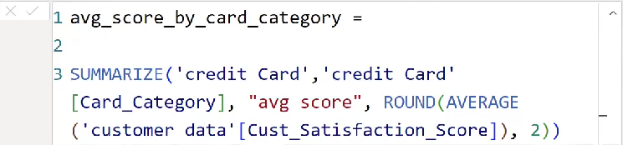
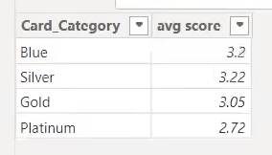
Q13.Average Customer Satisfaction Score by Credit Card Category: Calculate the average Cust_Satisfaction_Score by Card_Category.

Slide 28
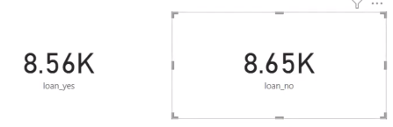
Q15.Loan Approval vs Credit Limit: Analyze how Credit_Limit affects Personal_loan approval by calculating the average credit limit for clients with and without loans.

Slide 29
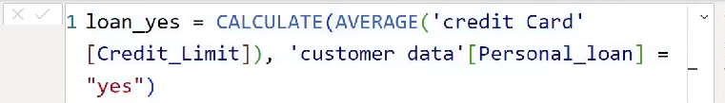
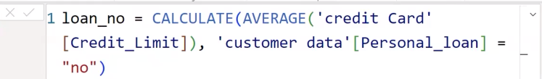

Slide 30
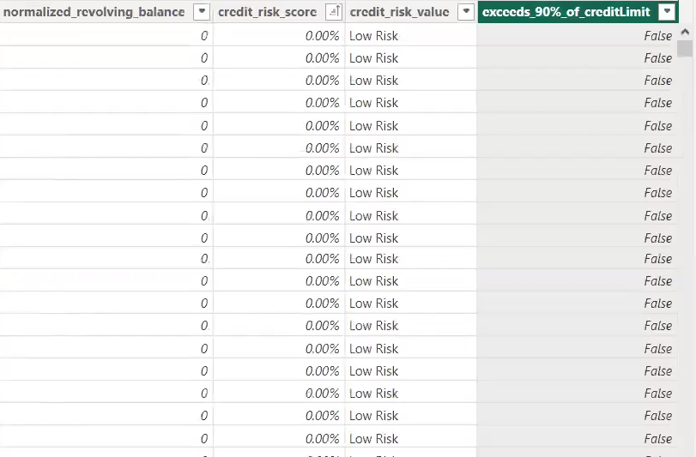
Q17.High Risk Clients Flag: Create a flag for clients whose Total_Revolving_Bal exceeds 90% of their Credit_Limit and who have a high Avg_Utilization_Ratio.

Slide 31
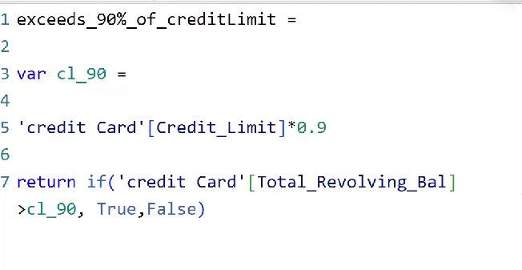

Slide 32
In conclusion, the analysis of credit card usage and financial metrics through Power BI and DAX functions has yielded invaluable insights into both the performance and behavior of our customer base. By examining running totals, moving averages, growth rates, and key performance indicators, we have developed a deeper understanding of spending patterns, credit utilization, and delinquency risks. The findings reveal several key areas of significance. The analysis has uncovered distinct trends in customer spending and engagement, which present opportunities for targeted marketing and the development of personalized financial products to enhance customer retention and satisfaction. Insights into credit utilization ratios have clarified how customers are leveraging their credit limits, providing critical information for optimizing credit offerings and managing risk. Additionally, by identifying patterns in late payments and defaults, we are better equipped to assess delinquency risks and implement proactive measures to reduce default rates and improve collections. Furthermore, the calculated growth rates and moving averages have illuminated the institution’s overall financial health, highlighting both strengths and areas for potential growth.

Slide 33







Thank You
Hopefully, this year's report can make our company even better

